Slide 1
Non-Public School Security Grant
Kimberly Daubenspeck
School Safety and Climate Coordinator, Office of School Safety and Transportation
© Tennessee Department of Education

Slide 3
Learn about the purposes of the Non-Public School Security Grant
Understand what is allowable use of grant funds
Know the grant timeline
Learn about the elements of the grant application and how to complete the application
Understand how to navigate the application in ePlan

Slide 4
Non-Public School Security Grant 2023-24
Non-Public_School_Security_Grant_Application.pdf (tn.gov)
Following the tragic events that occurred at Covenant School, Governor Bill Lee and the Tennessee General Assembly included a one-time, non-recurring investment of $14 million in non-public school security grants for the 2023-24 fiscal year state budget.

Slide 5
Use of Funds
Funds can be used to support a wide array of school safety efforts to include:
Improved physical school security
Perimeter control
Access control
Vehicle control
Visitor management
Communications
Surveillance
Safety signage
School Resource Officer
School Security Officer
Emergency Planning
Security Consultation
Safety Training
Be very detailed and clear about what you want to spend your funds on. Don’t say for example:
Safety equipment
Safety personnel (detail Armed or Unarmed Security Officer, School Resource Officer or Safety Consultant)
Other equipment as needed etc.

Slide 6
Not Allowable Use of Funds
Vape Detection Devices
K-9 Detection
Drones
ATVs, Golf Carts, Vehicles
Multi-Year contracts beyond the grant period that ends June 30, 2024.
School Counselors (this is one-time, non-recurring funding)
The following individual equipment purchases, outside of a service contract with a local law enforcement entity or security officer vendor:
Weapons (handguns, rifles, tasers etc.)
Weapons Related Accessories (ammunition, gun safes etc.)
Personal Protective Equipment (bulletproof vests, shields etc.)
Other Tactical Equipment used by Law enforcement (electronic distraction device)
Uniforms
To reduce liability on the school, these items should be purchased by the local law enforcement agency placing the SRO or vendor placing the Security Officer who trains them on how to properly use it.

Slide 7
Use of Funds Continued
Only schools considered non-public schools on this list may apply: https://www.tn.gov/content/dam/tn/education/nonpublic/Nonpublic_Schools_2023-24.xlsx
All equipment purchased through this grant must only be utilized within the property of brick-and-mortar school buildings that are subject to educational occupancy inspections by the State Fire Marshal.
Additionally, any services contracted must be linked to addressing the safety of students and staff within the property of those brick-and-mortar school buildings.
Ask Kimberly.Daubenspeck@tn.gov for a copy of the confidential Security Assessment Tool developed by the Dept of Safety and Homeland Security along with the 30-minute training video. (not required for private schools to conduct but a helpful tool)

Slide 8
Grant Timeline
June 1: Grant Information and Intent to Apply Form Released
June 7-August 2: Weekly Office Hours for Intent to Apply Support Every Wednesday, 9:00a.m. to 10:00a.m. CT
August 4: Deadline for Intent to apply
August 11: Grant Allocations Announced and Funding Application Opens in ePlan
August 15: Webinar on ePlan Funding Application
August 16-October 25: Weekly Office Hours for Grant Application Support Every Wednesday, 9:00a.m. to 10:00a.m. CT
October 27: Deadline to Receive Grant Applications

Slide 9
Elements of the Grant Application
Grant Contact: The name, email, and phone number of the person that the department should contact with questions about the grant application. This section is located in the cover page area of the ePlan funding application.
Project Budget: The following items should be provided in the budget area of the ePlan funding application:
The budget period for this grant is from the date the application is approved by the department until June 30, 2024. All approved purchases and expenditures must occur within this budget period to be eligible for reimbursement.
Each line item must include an application justification.
Be very detailed and clear about what you want to spend funds on in the Narrative Description. Don’t say for example:
Safety equipment (instead detail out all of the specific pieces of equipment)
Safety Personnel (instead, detail Armed or Unarmed Security Guard, SRO, or Safety Consultant) Keep in mind this is one-time, non-recurring funds.
Other equipment as needed
Refer to the revenue and expenditure account codes information provided below to properly code revenues and expenditures.

Slide 10
Expenditure Account Codes
Description | Account Code
Training provided to: Students, Parents, SROs, Community Teachers | 72130-524 Training for Students, Parents, SROs, Community 72210-524 Support Services-Instructional Staff
Equipment placed in School Buildings: | 72620 Support Services-Maintenance of Plant
Personnel hired or contracted: Security guard hired as contractor Behavioral health personnel SRO contracts with sheriff’s department | 72130-399 Security Guard 72130-189 Student Support Services 72130-170 SRO contracts with Sheriff’s Dept or local law enforcement

Slide 11
Navigating ePlan

Slide 12
Obtaining ePlan Access
Obtain access to ePlan by completing the User Access Form: https://stateoftennessee.formstack.com/forms/eplan_user_access_form_for_non_public_schools
ePlan site: https://eplan.tn.gov/default.aspx?ccipSessionKey=638252886667036056

Slide 13
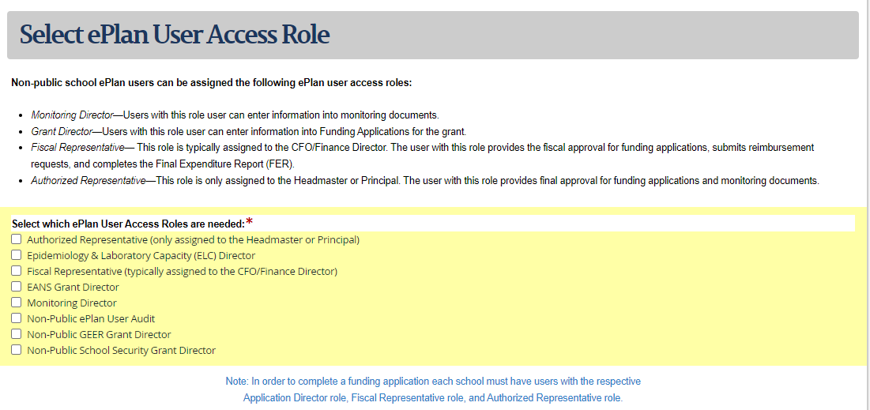
User Roles for ePlan Access
Three Roles are needed for application submittal.
The Authorized Representative and the Fiscal Representative cannot be the same person

Slide 14
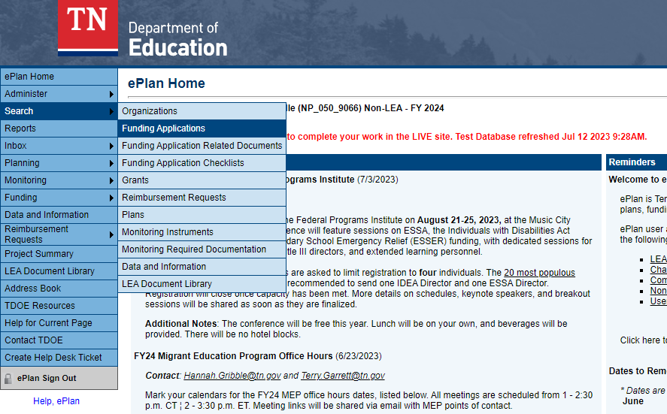
Select Funding Applications

Slide 15
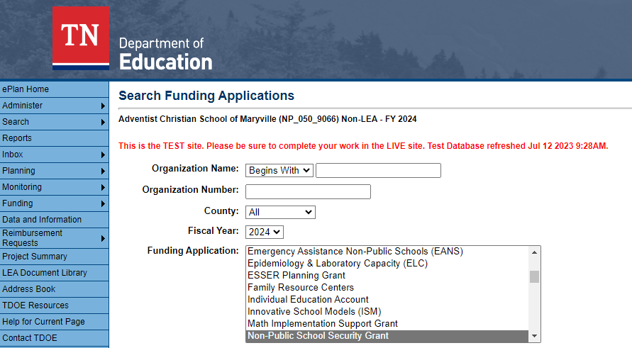
Select Fiscal Year 2024
Select Grant

Slide 16
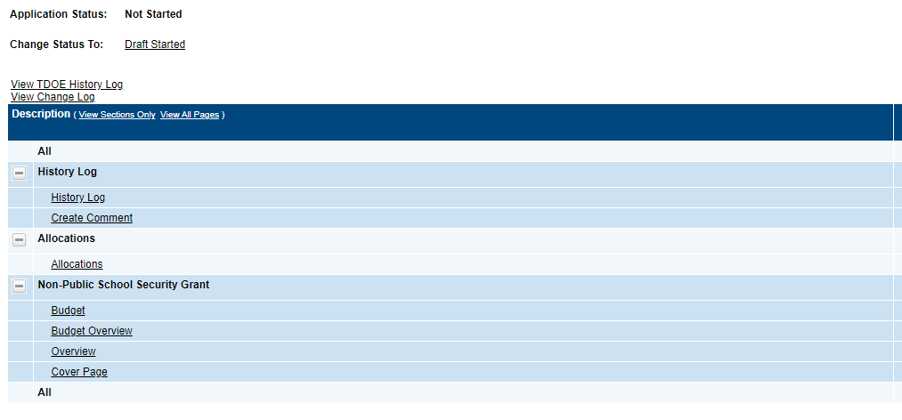
To start, you will need to click “Draft Started”
You will see your allocation here.

Slide 17
Provide grant contact information here.

Slide 18
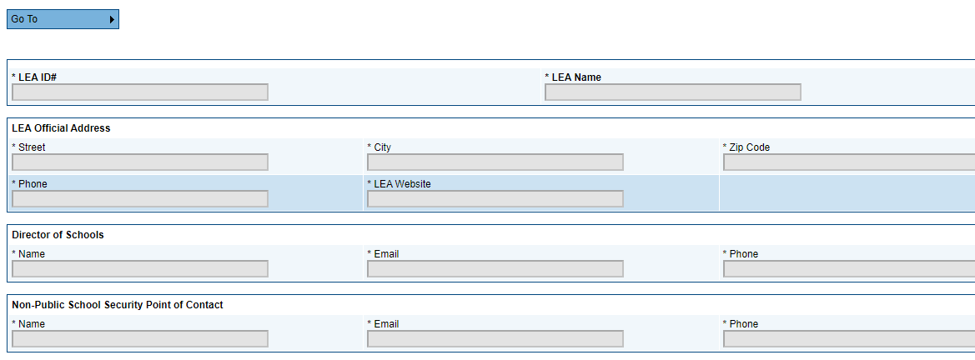
Provide School #
Provide School Name
Provide Address of School
Provide School Website
Provide School Administrator, Head of School, Principal, etc.

Slide 19
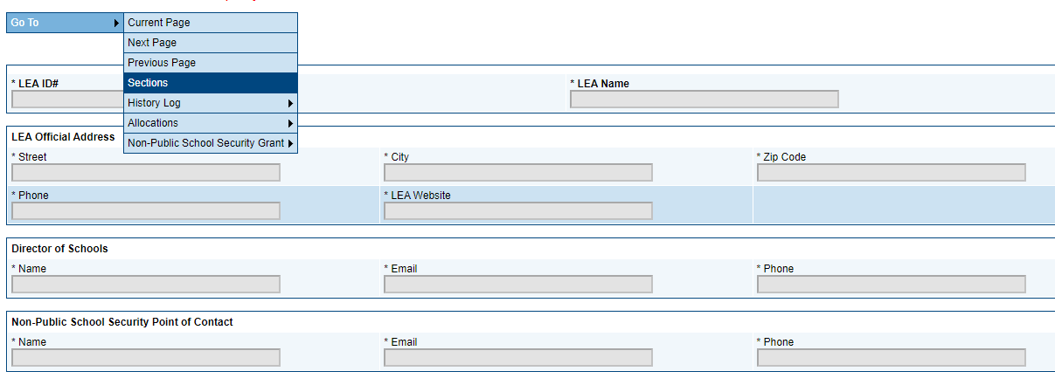
Click “Go To”
Click “Sections” to go back to Application

Slide 20
Click here to enter your budget

Slide 22
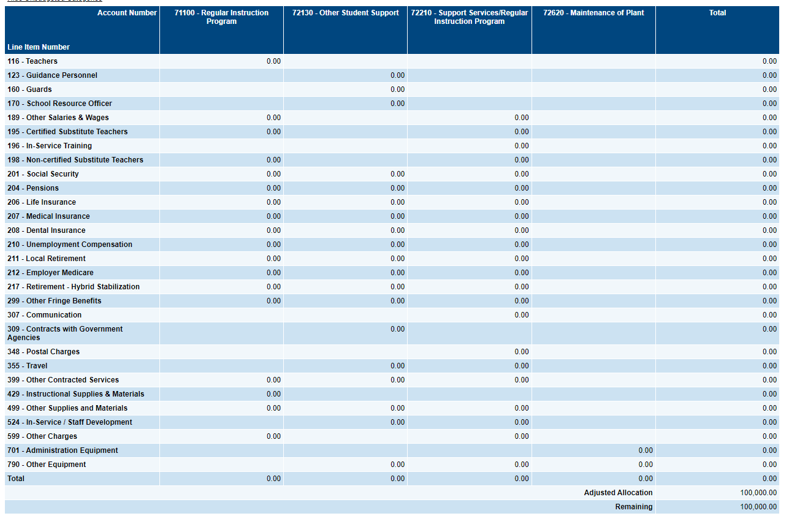
Allowable Budget Codes

Slide 23
ePlan Approval Chain
Draft Started
Draft Completed
LEA Fiscal Representative Approved
LEA Authorized Representative Approved
TDOE Public School Security Grant Director Approved

Slide 24
Weekly Office Hours
Every Wednesday August 16 through October 25 from 9:00am to 10:00am Central Time
Microsoft Teams meeting
Join on your computer, mobile app or room device
Click here to join the meeting
Meeting ID: 278 710 148 423 Passcode: zBfc9Y
Download Teams | Join on the web
Or call in (audio only)
+1 615-270-9704,,319060640# United States, Nashville
Phone Conference ID: 319 060 640#
Find a local number | Reset PIN

Slide 25
Thank You!
Kimberly Daubenspeck
School Safety and Climate Coordinator
Office of School Safety and Transportation
Kimberly.Daubenspeck@tn.gov
615-970-2418
Bennett Wilson
SAVE Act Program Coordinator
Office of School Safety and Transportation
Bennett.Wilson@tn.gov
615-968-4347
Permission is granted to use and copy these materials for non-commercial educational purposes with attribution credit to the “Tennessee Department of Education”. If you wish to use these materials for reasons other than non-commercial educational purposes, please contact Joanna Collins (Joanna.Collins@tn.gov).

