Slide 1
EIS Staff Data
Trish Kelly | Data Manager | Office of Districts and Schools| August 2022

Slide 3
Agenda
EIS Staff Data Business Rules
Staff Current Assignments Research Query
Staff Assignment and Funding Source FTE: Sample Scenarios
Resources
Contact Information

Slide 4
EIS Staff Data Business Rules

Slide 5
Staff Assignments are Tied to School Years
Staff assignments and funding source FTEs are year-specific.

Slide 6
Staff Assignment Begin Date
Enter staff assignment begin dates each year to identify staff with assignments for the year.
For example, enter the first day of the 2022-23 school year (e.g., 8/3/2022).

Slide 7
Staff Assignment End Dates
Enter assignment end dates for staff who do not complete the year.
For example, enter 9/15/2022 for a staff member whose assignment ends on Sept. 15, 2022.
Entering end dates ensures that assignment data are accurate.

Slide 8
Staff Assignment End Dates
For staff who complete the year, an end date may be used or it may be omitted.
For example, at the end of the 2022-23 school year, enter the last day of the assignment (e.g., 5/28/2023).
Or use a blank value to indicate that the staff member completed the year.
Check with your SIS vendor on the best approach for your SIS package.

Slide 9
Assignments and Funding Source FTEs
LEAs submit one record in SIS/EIS per year, staff member, school, and assignment.
Each staff assignment record includes three funding source fields that are reported in full-time equivalents (FTEs):
federal funding source,
state/local funding source, and
other funding source.

Slide 10
Funding Source FTEs Range between 0 and 1
Funding source FTEs are expected to range between 0 and 1.
1 indicates that the assignment is full-time and entirely funded by one funding source.
0 indicates that the funding source did not support the assignment.
Values between 0 and 1 are used to report funding for assignments that are less than full-time or funded by multiple sources.
Funding source FTEs summed across all assignments total 1 for licensed, full-time, school-based staff members and less than 1 for part-time staff members.

Slide 11
Null Values and Decimal Places
For funding source FTES, EIS will accept null values and zero to three decimal places.
Using 0 as an example, accepted values are 0, 0.0, 0.00, and 0.000.
Using .5 as an example, accepted values are 0.5, 0.50, and 0.500.
Using 1 as an example, accepted values are 1, 1.0, 1.00, and 1.000.

Slide 12
Staff Current Assignments Research Query

Slide 13
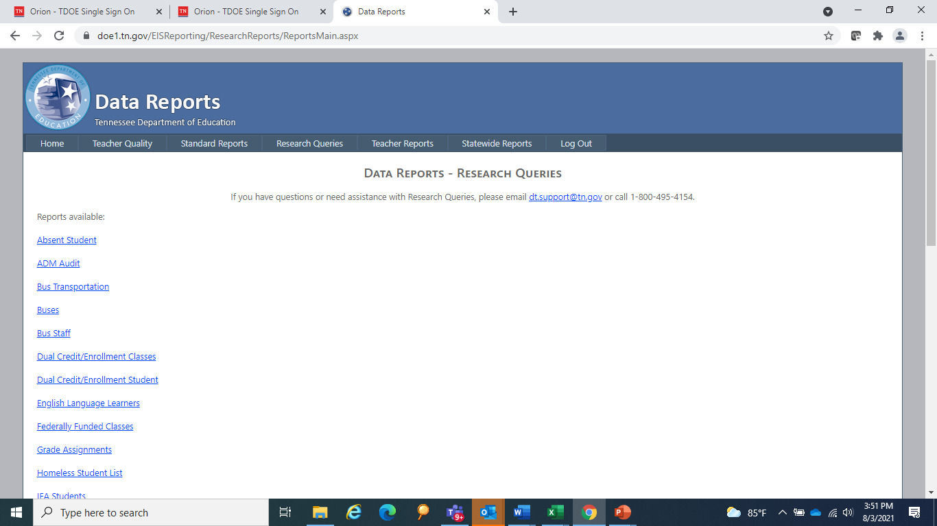
Staff Current Assignments Research Query
To check your data in EIS, log in as a district or school user.
Select Data Reports / Research Queries.
From the research query list, select the Staff Current Assignments.

Slide 14
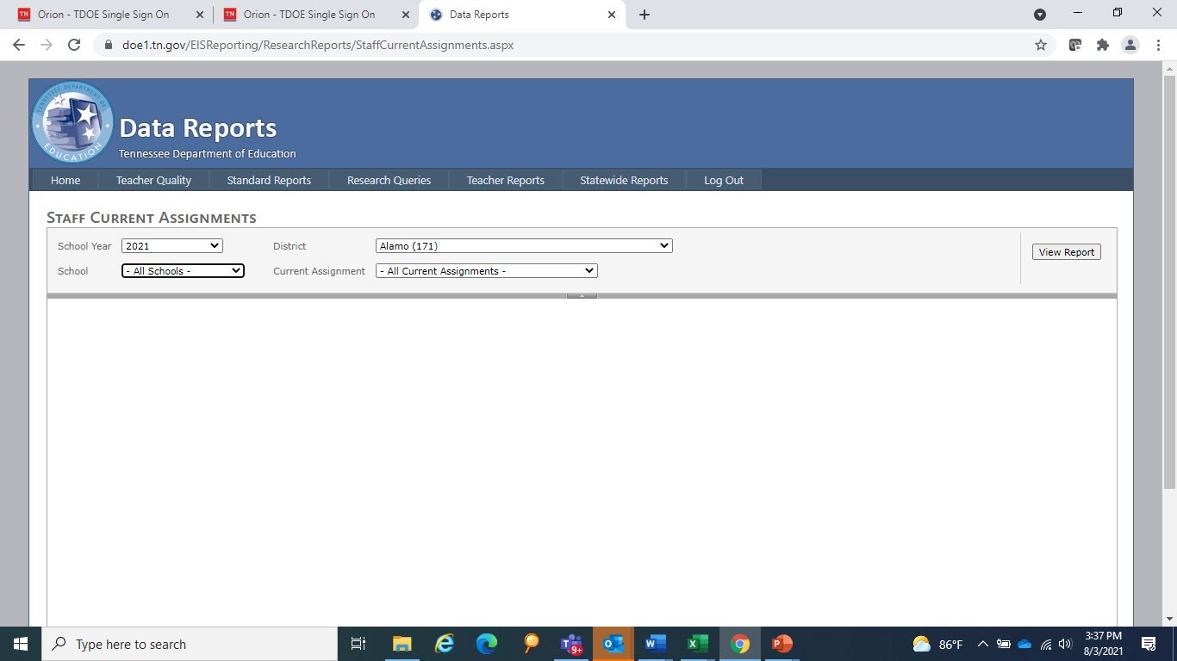
Staff Current Assignments Research Query
Select Year and enter 2022 for the 2022-23 school year.
Select a School or All Schools.
Select a specific assignment code or select All Current Assignments.
To run the report, select View Report.
To download to an Excel or csv file, select the file icon to the right of Find | Next.

Slide 15
Staff Current Assignments Research Query Results
School and staff identifiers are on the left.
Staff current assignments, assignment begin and end dates, three funding source FTEs (federal, state/local, and other), and email address are on the right.
Sort the data by school, name, and assignment code.
Note that the data will include all staff with assignments entered in SIS and uploaded to EIS.

Slide 16
Staff Assignment and Funding Source FTE: Sample Scenarios

Slide 17
One Full-Time Assignment and One Funding Source
One Full-Time Assignment and One Funding Source
LEAID | LEA | SCHID | School | Lic No | First Name | Last Name | Staff Current Assignment Code | Staff Current Assignment | Federal Funding Source FTE | State/Local Funding Source FTE | Other Funding Source FTE
1 | LEA 1 | 5 | School 5 | 1 | Zebra | Apple | G1 | Grade 1 Teacher | 0 | 1 | 0
1 | LEA 1 | 5 | School 5 | 2 | Rhino | Peach | ESL | ESL Teacher | 0 | 1 | 0
1 | LEA 1 | 5 | School 5 | 3 | Cat | Kiwi | 7C | Special Education Teacher | 1 | 0 | 0
1 | LEA 1 | 5 | School 5 | 4 | Dog | Banana | IC | Instructional Coach | 1 | 0 | 0
1 | LEA 1 | 5 | School 5 | 5 | Hamster | Cherry | SW | Social Worker | 0 | 0 | 1

Slide 18
One Full-Time Assignment and Two Funding Sources
One Full-Time Assignment and Two Funding Sources
LEAID | LEA | SCHID | School | Lic No | First Name | Last Name | Staff Current Assignment Code | Staff Current Assignment | Federal Funding Source FTE | State/Local Funding Source FTE | Other Funding Source FTE
1 | LEA 1 | 5 | School 5 | 3 | Cat | Kiwi | 7C | Special Education Teacher | 0.5 | 0.5 | 0
1 | LEA 1 | 5 | School 5 | 4 | Dog | Banana | IC | Instructional Coach | 0.25 | 0.75 | 0

Slide 19
Two Half-Time Assignments: Different Subjects
Two Half-Time Assignments: Different Subjects
LEAID | LEA | SCHID | School | Lic No | First Name | Last Name | Staff Current Assignment Code | Staff Current Assignment | Federal Funding Source FTE | State/Local Funding Source FTE | Other Funding Source FTE
1 | LEA 1 | 5 | School 5 | 20 | Horse | Ranch | G1 | Grade 1 Teacher | 0.0 | 0.5 | 0
1 | LEA 1 | 5 | School 5 | 20 | Horse | Ranch | G2 | Grade 2 Teacher | 0.0 | 0.5 | 0

Slide 20
Three One-Third Assignments: Same Subject
Three One-Third Assignments: Same Subject
LEAID | LEA | SCHID | School | Lic No | First Name | Last Name | Staff Current Assignment Code | Staff Current Assignment | Federal Funding Source FTE | State/Local Funding Source FTE | Other Funding Source FTE
1 | LEA 1 | 5 | School 5 | 30 | Rhino | Peach | ESL | ESL Teacher | 0.0 | 0.33 | 0
1 | LEA 1 | 10 | School 10 | 30 | Rhino | Peach | ESL | ESL Teacher | 0.0 | 0.33 | 0
1 | LEA 1 | 15 | School 15 | 30 | Rhino | Peach | ESL | ESL Teacher | 0.0 | 0.33 | 0

Slide 21
Three Part-Time Assignments: Not Full-Time
Three Part-Time Assignments: Not Full-Time
LEAID | LEA | SCHID | School | Lic No | First Name | Last Name | Staff Current Assignment Code | Staff Current Assignment | Federal Funding Source FTE | State/Local Funding Source FTE | Other Funding Source FTE
1 | LEA 1 | 20 | School 20 | 100 | Bear | Berry | HB | Grade 9-12 Math Teacher | 0.0 | 0.40 | 0
1 | LEA 1 | 30 | School 30 | 100 | Bear | Berry | HB | Grade 9-12 Math Teacher | 0.0 | 0.25 | 0
1 | LEA 1 | 40 | School 40 | 100 | Bear | Berry | HB | Grade 9-12 Math Teacher | 0.0 | 0.15 | 0

Slide 22
Resources

Slide 23
EIS Data Dictionary Appendix I – Staff Current Assignments
For K-12 instructional staff current assignments and codes, refer to EIS Data Dictionary Appendix I - Staff Current Assignments (https://www.tn.gov/content/dam/tn/education/technology/eis_appendices_2022-2023-20220720.pdf).

Slide 24
Staff Assignments for Comparability
For staff assignments included in and excluded from comparability reporting, see EIS Staff Current Assignments for Comparability: 2022-23, which is available in in ePlan.
Select TDOE Resources and follow the pathway: Data and Information Tools > Comparability > 2022-23. (A login is not required for the ePlan > TDOE Resources folder.)

Slide 25
EIS Staff Data for Comparability and Checking EIS Staff Data “Five-Pager”
A five-page summary of EIS staff data for comparability including business rules and instructions for the Staff Current Assignments research query is available in ePlan.
Select TDOE Resources and follow the pathway: Data and Information Tools > Comparability > 2022-23. (A login is not required for the ePlan > TDOE Resources folder.)

Slide 26
Contact Information

Slide 27
Contact Information
If you have questions about staff data and coding, please contact Trish Kelly, FPO Data Manager at Trish.Kelly@tn.gov.
For questions about comparability requirements, please contact your assigned divisional coordinator.
For EIS errors and restaging problems, please contact the district technology support team at dt.support@tn.gov.

Slide 28
Thank You!
#TNBestforAll

Slide 29
Fraud, Waste or Abuse
Citizens and agencies are encouraged to report fraud, waste, or abuse in State and Local government.​
​
NOTICE: This agency is a recipient of taxpayer funding. If you observe an agency director or employee engaging in any activity which you consider to be illegal, improper or wasteful, please call the state Comptroller’s toll-free Hotline:​
​
1-800-232-5454​
​
Notifications can also be submitted electronically at:​
​
http://www.comptroller.tn.gov/hotline

