Slide 1
Foster Care Overview and Requirements for Transportation Procedures
December 2018

Slide 2
Erin Christian Non-traditional Educational Programs Consultant Consolidated Planning & Monitoring Erin.Christian@tn.gov (901) 504-9627

Slide 3
Agenda
Introduction
Definition of Foster Care
Overview
Policy vs. Procedure
Components for Foster Care Procedures
Point of Contact
Best Interest Determination Meeting
Transportation
Enrollment
Timeline
Collaboration

Slide 4
What is foster care?
“Foster care” means 24-hour substitute care for children placed away from their parents or guardians and for whom Department of Children's Services (DCS) has placement and care responsibility.
This includes placements in foster family homes, foster homes of relatives, group homes, emergency shelters, residential facilities, child care institutions, and pre-adoptive homes.
The Title I foster care provisions apply to all children in foster care enrolled in public schools.

Slide 5
Children in Foster Care
Are often a vulnerable and highly mobile student population
Experience more unscheduled school changes than their peers in a given school year
Experience (compared to their peers not in foster care):
LOWER high school graduation rates;
LOWER scores on academic assessments; and
HIGHER rates of retention, absenteeism, suspensions, and expulsions

Slide 6
Foster Care in ESSA
Children and youth in foster care represent one of the most vulnerable student subgroups in this country. Of the approximately 415,000 children in foster care in 2014, nearly 270,000 were in elementary and secondary schools.
Studies find that children in foster care are much more likely than their peers to struggle academically and fall behind in school.

Slide 7
Fast Facts from National Datasheet

Slide 8
What the Research Shows

Slide 9
Links Between Mobility and Graduation

Slide 10
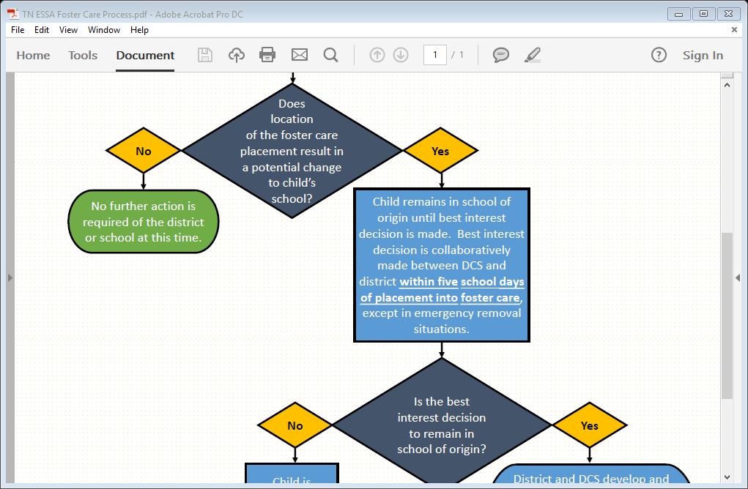
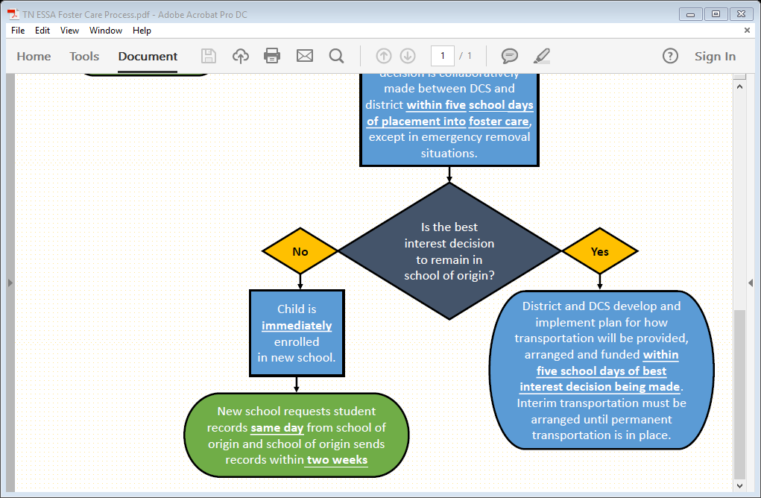
Foster Care Educational Stability Overview

Slide 11
Foster Care Blueprint for Change: Goals for Youth
Goal 1: Remain in the Same School
Goal 2: Seamless Transitions Between Schools
Goal 3: Young Children are Ready to Learn
Goal 4: Equal Access to the School Experience
Goal 5: School Dropout, Truancy, and Disciplinary Actions Addressed
Goal 6: Involving and Empowering Youth
Goal 7: Supportive Adults as Advocates and Decision-makers
Goal 8: Obtaining Postsecondary Education

Slide 12
Requirements for LEAs Serving Youth in Foster Care

Slide 13
Policy vs. Procedure
Policies | Procedures
Have widespread application | Have a narrower focus
Are non-negotiable, change infrequently | Are subject to change and continuous improvement
Are expressed in broad terms | Are a more detailed description of activities
Are statements of what and/or why | Are statements of how, when and/or who & sometimes what
Answer major operational issues | Detail a process

Slide 14
Components of LEA Procedures
Point of Contact
Best Interest Determination Meeting
Transportation
Enrollment
Training
Review Plan with DCS Educational Specialist

Slide 15
Point of Contact: Guidance Provisions
LEA POCs should have the capacity and resources to guide the implementation of the ESSA provisions.
Each LEA should have a POC designated to coordinate services for all students in foster care. Responsibilities should include coordinating with regional DCS offices to develop a process for implementation of ESSA provisions.

Slide 16
Best Interest Determinations: ESSA Requirements
The district must provide assurances that:
Children in foster care enroll or remain in the school of origin unless there is a determination that it is not in his or her best interest to attend the school of origin.
The best interest determination must be based on all factors, including:
appropriateness of the current educational setting and
proximity to the school in which the child is enrolled at the time of placement.

Slide 17
Best Interest Determinations: Guidance Provisions
The Best Interest Determination (BID) team should consider multiple student-centered factors
Transportation costs should not be a factor
The BID team should consult the child, if appropriate, and adults who have meaningful relationships with child

Slide 18
Best Interest Determinations: Guidance Provisions
If the LEAs cannot come to agreement, the ultimate decision should reside with DCS.
LEAs must coordinate with DCS to develop a dispute resolution process.
To the extent feasible and appropriate, a child must remain in his or her school of origin while awaiting a decision to reduce the number of school moves.

Slide 19
Best Interest Determination Checklist (example)
Student Name: | DOB: |  | Determination Decision: (circle one) School of Origin or Local School
Best Interest Determination | Consideration |  | Evidence
 | School of Origin | Local School
Preference of the child
Preference of the educational decision maker
Child’s attachment to school
Placement of the child’s sibling(s)
School Climate
Educational and social emotional needs
Need for services and supports under IDEA or 504
Academic needs (EL, Advanced Academics, etc.)

Slide 20
Transportation Procedures: ESSA Requirements
LEAs must provide assurances that they will collaborate with DCS to:
Develop and implement clear written procedures for how transportation will be provided, arranged, and funded for the duration of the time in foster care.
Procedures must ensure that children will promptly receive transportation in a cost-effective manner in accordance with the Fostering Connections Act.

Slide 21
Transportation Procedures: ESSA Requirements
LEAs must provide assurances that they will collaborate with DCS to:
Ensure that, if there are additional costs incurred in providing transportation to the school of origin, LEAs will provide transportation if:
DCS agrees to reimburse the LEA;
The LEA agrees to pay the cost; or
The LEA and DCS agree to share the cost.

Slide 22
Transportation Requirements: Guidance Provisions
Transportation must be provided in a “cost-effective” manner, so low-cost/no-cost options should be explored.
Even if an LEA does not transport other students, it must ensure that transportation is provided to children in foster care consistent with procedures developed in collaboration with DCS.
Transportation is an allowable use of federal funds, both under Title IV-E of the Social Security Act and Title I of the ESEA.
All funding sources should be maximized to ensure costs are not unduly burdensome on one agency.

Slide 23
Immediate Enrollment: ESSA Requirements
LEAs must provide assurances that:
If it is not in the child’s best interest to stay in his or her school of origin, the student must be immediately enrolled in the new school, even if the child is unable to produce records normally required for enrollment.
The enrolling school shall immediately contact the school last attended to obtain relevant academic and other records.

Slide 24
Immediate Enrollment: Guidance Provisions
A child cannot be denied enrollment because he/she does not have proper documentation.
The child should also be attending classes and receiving appropriate academic services.
The department and LEAs should review policies to remove barriers to immediate enrollment.

Slide 25
Training
LEAs should ensure that all staff involved with the enrollment of students should be trained and understand these procedures.
This may include:
Front Desk Receptionist
Principal and Assistant Principal
School Counselors
Administrative Assistants

Slide 26
Checklist for a Comprehensive Procedure
DCS will notify district POC that student is in custody
Collaboration with local child welfare agency
BID Meeting held within 5 days
District has transportation arranged and implemented within 5 days
Clear, written procedures for transportation implemented
Ensure that any barriers to enrollment have been eliminated
Develop a dispute resolution process
Appropriate transportation provided during time student is in care

Slide 27
Timeline

Slide 28
Timeline
DCS should notify the LEA POC of a child entering foster care within 1-2 days of the event
A Best Interest Determination (BID) meeting should occur within 5 days of the notification
Permanent transportation should be arranged for the child within 5 days of the BID

Slide 29
Exemplary Procedure
Procedures for Students in Foster Care: Best Interest Determination
The Every Student Succeeds Act (ESSA) contains key protections for students in foster care that are designed to promote school stability, student success, and collaboration between local education agencies (LEAs) and child welfare agencies.
Definitions
“Foster Care” is defined as 24 hour substitute care for children placed away from their parents or guardians for whom the child welfare agency has placement and care responsibility.
“School of origin” is the school in which a child is enrolled at the time of placement in foster care. If a child’s foster care placement changes, the school of origin would then be considered the school in which the child was enrolled at the time of the placement change.
Point of Contact
Upon a student coming into custody or upon a student changing placement while in custody, the DCS Child and Family Team (CFT) will discuss if it is in the best interest of the student to remain in the school of origin. If the team believes that the student should remain in the school of origin, the DCS Point of Contact (the Education Specialist) will notify the Point of Contact for school system to arrange a Best Interest Determination Meeting. This is part of the collaborative process of ESSA and must take place. A description of the process is provided below. NOTE: Only the Education Specialist should contact the school system regarding keeping students in the school of origin. The County School System is not expected to communicate with foster parents, parents, family service workers, etc. at the onset of this process.
Best Interest Determination Process
The DCS Education Specialist will notify the point of contact of the LEA if there is a student who DCS would like to keep in the school of origin, but who will no longer be living in that school’s zone. At that point the school system and DCS can schedule a best interest determination team meeting within 5 school days that includes:
The DCS point of contact (DCS POC);
The LEA point of contact (LEA POC);
The educational decision maker for the child or youth; DCS will contact the birth parent)
The school principal of designee; and
Any other key partners for decision making.
At this meeting, the Best Interest Determination Form will be completed.
If the team decides it is in the best interest of the student to remain in the school of origin, then the student will be allowed to remain. Transportation to the school of origin should then be discussed by the team (Reference Transportation to School of Origin Form).
If the team decides it is not in the best interest of the student to remain in the school of origin, DCS will enroll the student in the new school. If this school is in the same LEA as the school of origin, the child will be enrolled immediately.

Slide 30
Collaboration

Slide 31
Effective Collaboration: Guidance Provisions
To facilitate effective collaboration, the department, LEAs, and DCS should:
collaborate, as appropriate, across district, region, and state lines;
cross-train staff on the complex needs of children in foster care and the importance of educational stability;
establish formal mechanisms to ensure LEAs are notified when child enters care; and
build capacity to collect and use data to support outcomes for children in foster care.

Slide 32
Resources

Slide 33
Memo from TDOE

Slide 34
Resources
ED Foster Care Transition Toolkit
ED/HHS Joint Guidance
NAEHCY Resources
Fostering Success in Education: National Factsheet on the Educational Outcomes of Children in Foster Care.
http://www.fostercareandeducation.org/DesktopModules/Bring2mind/DMX/Download.aspx?portalid=0&EntryId=2100&Command=Core_Download
www.fostercareandeducation.org/AreasofFocus/BlueprintforChange.aspx
https://neglected-delinquent.ed.gov/

Slide 35
Review
Introduction
Definition of Foster Care
Overview
Policy vs. Procedure
Components for Foster Care Procedures
Point of Contact
Best Interest Determination Meeting
Transportation
Enrollment
Timeline
Collaboration

Slide 36
Questions

Slide 38
FRAUD, WASTE, or ABUSE
Citizens and agencies are encouraged to report fraud, waste, or abuse in State and Local government.
NOTICE: This agency is a recipient of taxpayer funding. If you observe an agency director or employee engaging in any activity which you consider to be illegal, improper or wasteful, please call the state Comptroller’s toll-free Hotline:
1-800-232-5454
Notifications can also be submitted electronically at:
http://www.comptroller.tn.gov/hotline

